Slide 1
Pay7
saaton din karo pay

Slide 2
Introduction
E-wallet is an online prepaid account where one can stock money, to be used when required.
As it is a pre-loaded facility, consumers can buy a range of products from airline tickets to grocery without swiping a debit or credit card.

Slide 3
How to use an E-Wallet
Sign in with Mobile Number
look for E-Wallet
Create new wallet for yourself
When buying something from the site, use your e-wallet to redeem as much cash as required
Transfer money to the account using online transfer, or your Debit card /Credit card/UPI
In case your balance in the e-wallet falls short, the balance payment can be done using traditional payment option.

Slide 4
What are the Benefits?
The sites where e-wallet services are available generally have the following few easy steps to get started.
Ease of use without having to enter your debit/credit card details for every online transaction.
Instant cashless payment, no need to swipe a credit card or debit card.
They also provide option for securely storing your Card details, thus providing you additional security at the same time reducing your work to type in Credit or Debit Card numbers each time you intend to transact online.
For some sites there is no minimum amount and you can deposit an amount as low as Rs 10.

Slide 5
Continue
Get reward and discount offers on every purchase using wallet.
Get extra cashbacks for every amount spent using wallet.
The money will be refunded in case of failure in the transaction
You can pass on the benefits of your e-wallet to your friends and family as well. There is no chance of a decline of payment since e-wallet is a prepaid account.
No need to access your bank account for making e-payment.

Slide 6
Disadvantage
Companies must ensure that their customers' information is encrypted and well protected. One of the biggest concerns of adopting a digital wallet application is "will my information be safe"? This is the hurdle that companies must face and as a result, must develop security systems that are as safe and full proof as possible to avoid potential security issues.
You cannot redeem your money back from the wallet you need to make purchase to use this money.
If you lose your mobile your wallet is lost.
You can use wallet till your mobile battery lasts.
It may be possible that you will end up spending more money using wallet.

Slide 7
What does mobile wallet has today?
NFC, NFC-HCE(Host card emulation), Cloud, QR code, SMS, or
BLE (Bluetooth low-energy) enabled.
Big data, analytics included.
Biometrics included.
User can manage and operate credit, debit, transport, loyalty and gift cards.
Bluetooth low-energy beacons integrated with geo-fencing.
Recommendation engine that tailors according to the user’s purchase history.
Integrated Customer insight manager.
Integrated Trusted service manager.

Slide 8
Step for using E-wallet
Follow the steps given below to use e-wallet.
Step -1 Download mobile wallet or e-wallet application
Step-2 Register and create new wallet by providing information
Step-3 Load money in your wallet from your bank using credit card or debit card
Step-4 Make a payment using e wallet

Slide 9
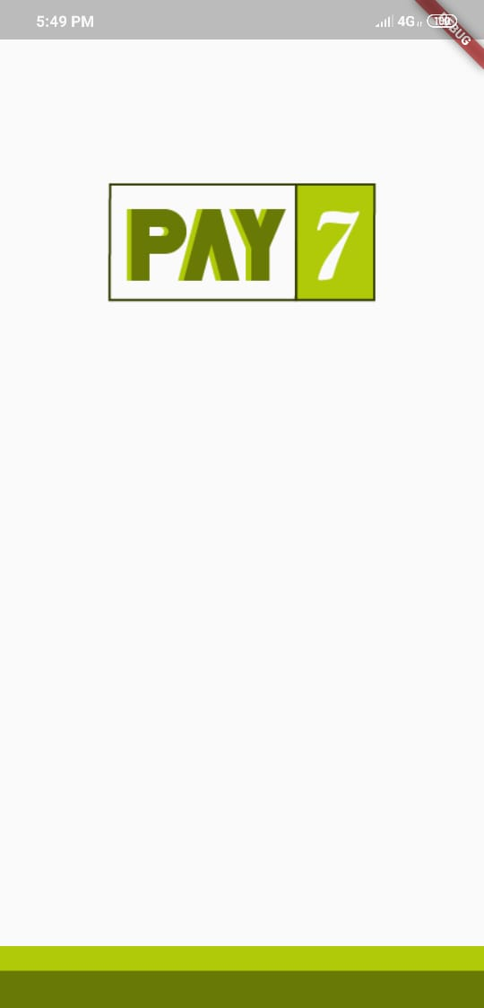
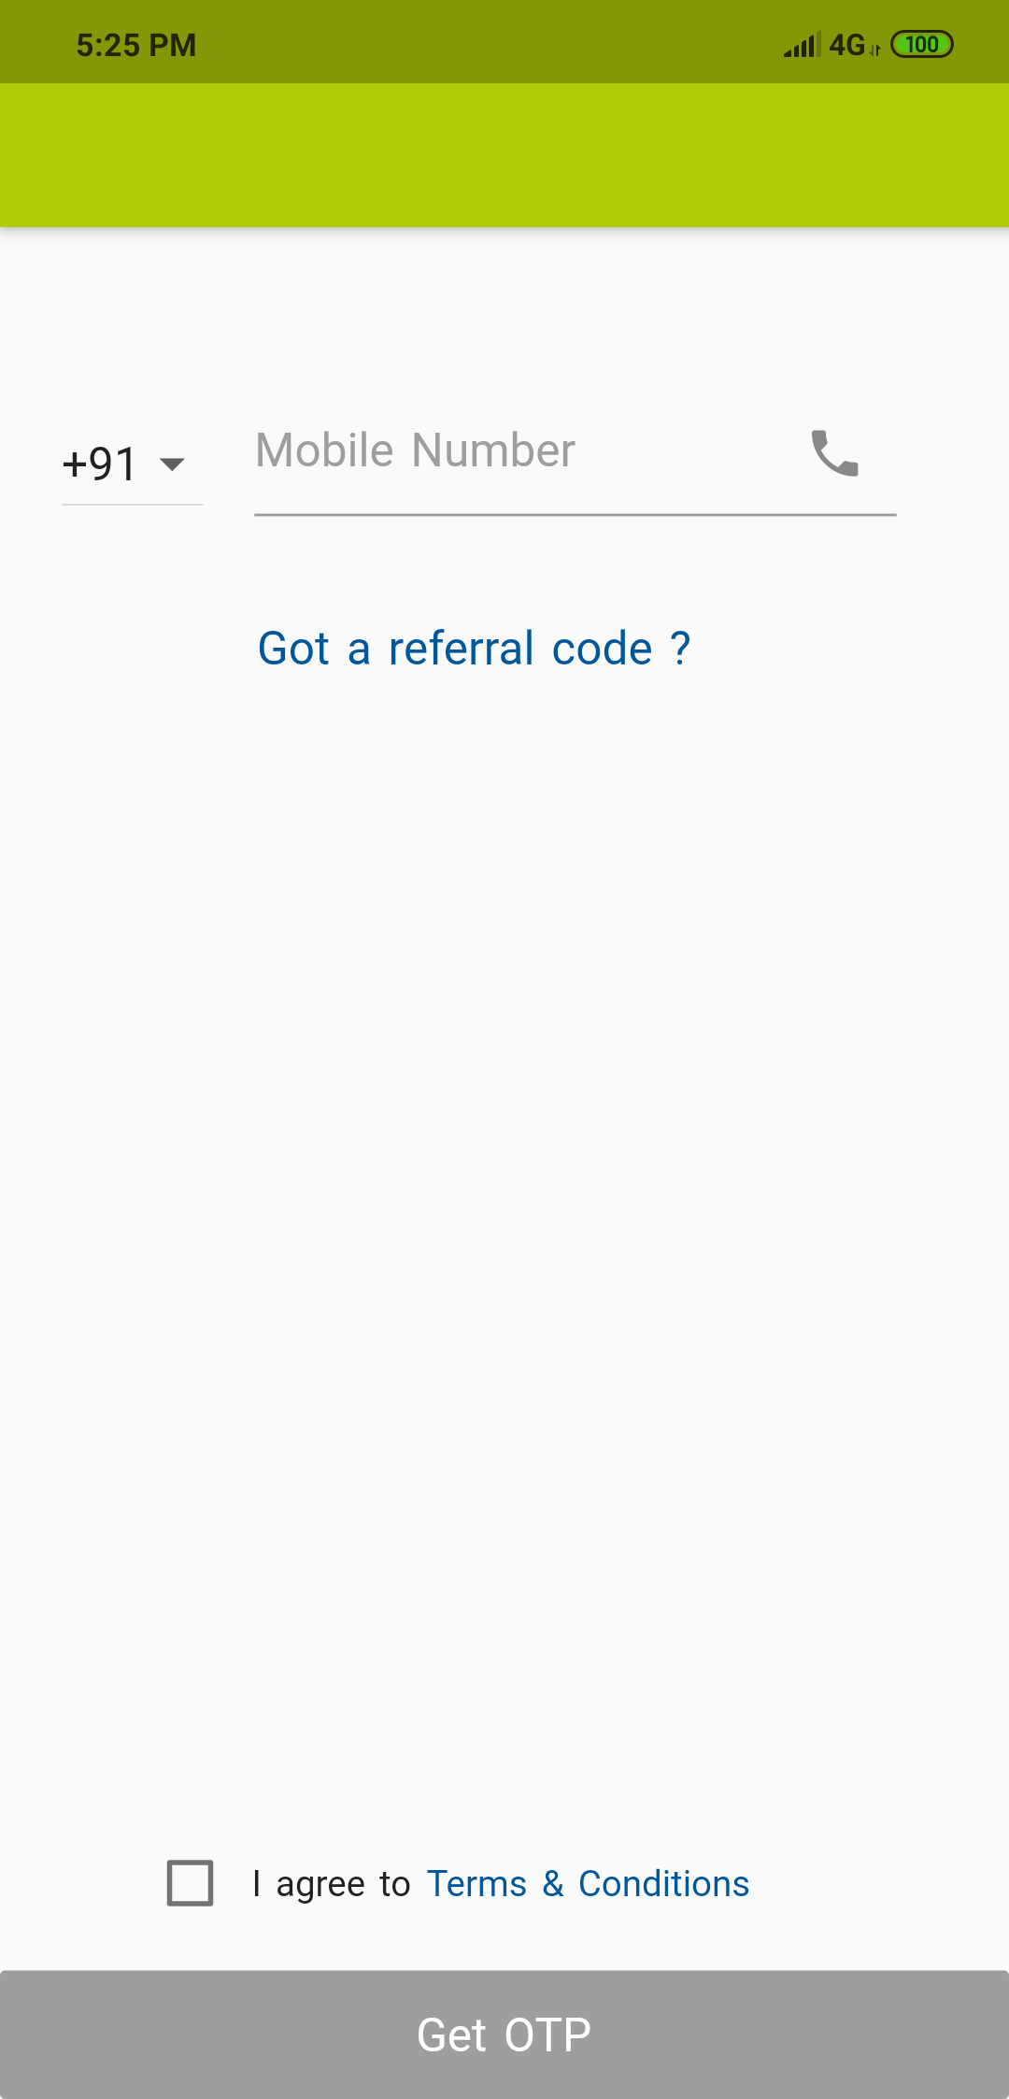
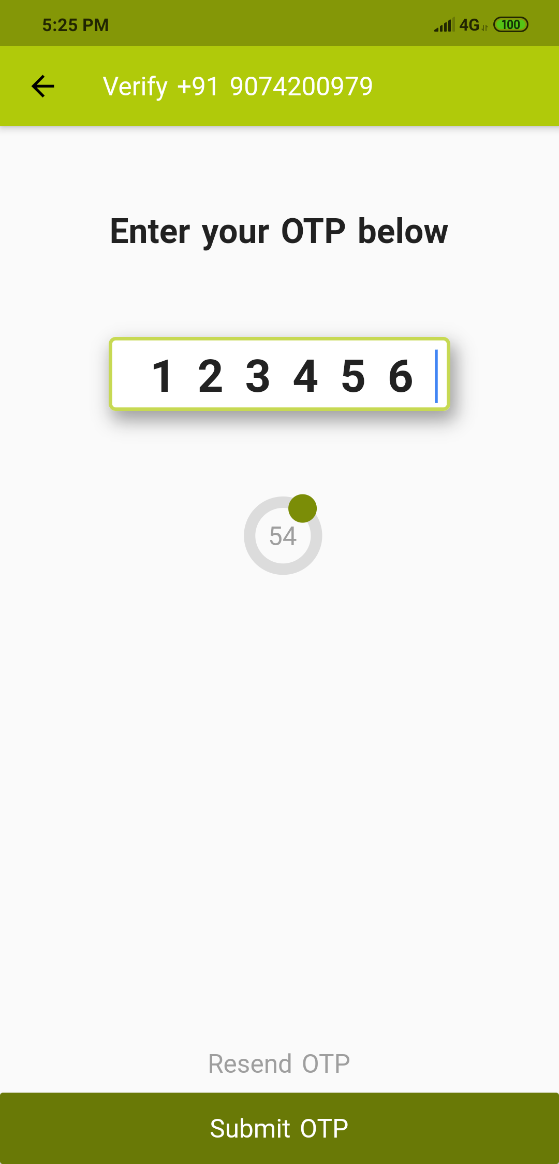
Application preview

Slide 10
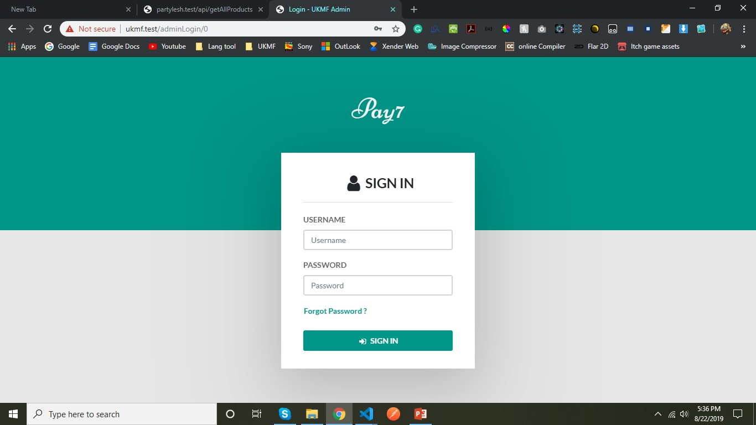
Setup Panel preview

Slide 11
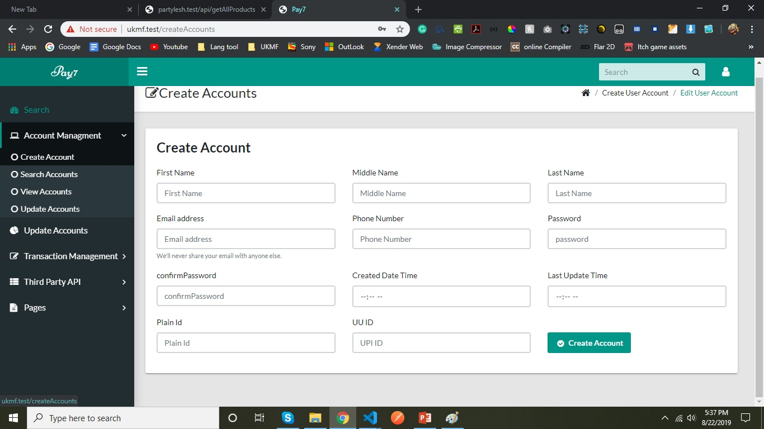

Slide 12
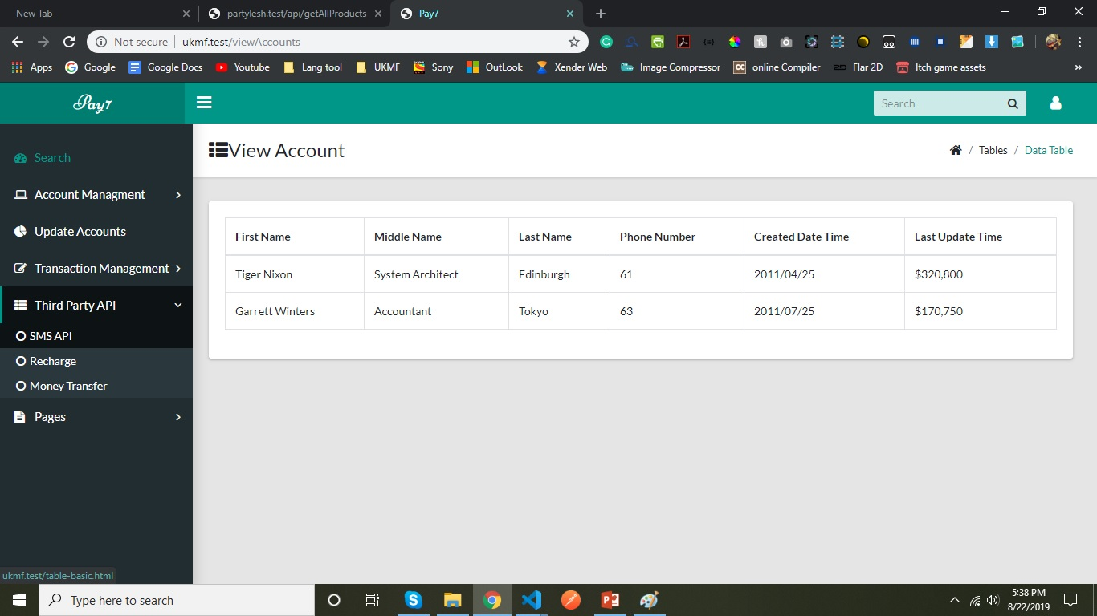

Slide 13
THE END

